Slide 1

Employee Attrition
GROUP NUMBER: 19
Linette Correia - A004
Suzet Machado - A032

Slide 2

WHAT IS ATTRITION?
__________________________________
The gradual but deliberate reduction in the number of employees through retirement, resignation or death and are not immediately replaced is called attrition.
Also be said as Employee Turnover or Employee Defection.
Modern managers and personnel administrators are greatly interested in reducing attrition in the organization, in such a way that it will contribute to the maximum effectiveness, growth, and progress of the organization.

Slide 3
PURPOSE OF THE STUDY
__________________________________
CAUSES
Lack of growth and progression Being overworked Little opportunity for decision making Lack of feedback and recognition Expecting better income and benefits Ineffective manager
IMPACTS
Affects profitability Loss of valuable knowledge Loss of belief in team's competence Its not quick and easy to replace

Slide 4
OBJECTIVES
__________________________________
To predict the employee attrition for IBM.
To determine the highly contributing factors which affects employee attrition.
1
2

Slide 5
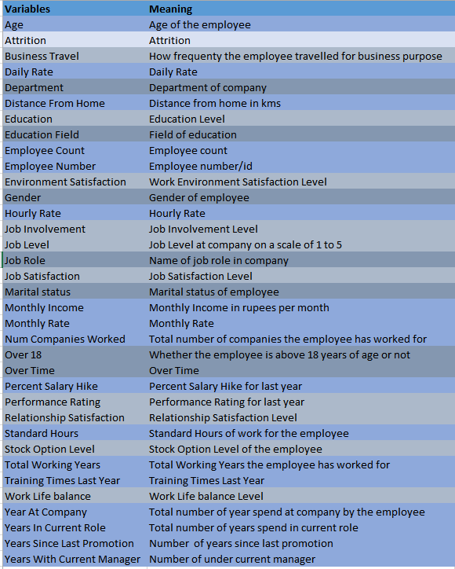
DATA DESCRIPTION
_________________
Source: Kaggle- IBM HR Analytics Dataset
Size of the data: 1470 observations
Variable Count: 35
Dependent Variable: Attrition
Independent Variables: 34 (7 Categorical Variables, 10 Ordinal Variables & 17 Numeric Variables.)

Slide 6
DATA CLEANING AND PROCESSING
__________________________________
Dropping Non-Relevant features:
4 columns were removed from the data, making the count of columns to 31.
Datatype checking:
Variables with multiple levels which were of integer datatype changed to object datatype.
Missing Values:
No Missing Values Were Present in the Data.
Outliers:
Outliers were detected.
Not treated, since removing them would lead to biasedness .
.

Slide 7
EMPLOYEE ATTRITION( Dependent Variable)
__________________________________
Attrition
Yes
Employee Leaves
No
Employee Doesn’t Leaves
There are 1470 observations, consists of 237 observations attrition(leave), and the rest of 1233 observations are all non-attrition(stay). As we have seen here, the proportion of attrition is nearly 16%(237/1470), which shows that this dataset is highly unbalanced.

Slide 8
EXPLORATORY DATA ANALYSIS
Employee Attrition by Age ,Gender
Major attrition occurred among the mid-career level employees.Career change and Career Growth could be one of the possibility.
Male employees tend to have a little higher attrition rate than female employees.

Slide 9
EXPLORATORY DATA ANALYSIS
Employee Attrition by Education Level ,Marital Status
Employees with lower education level are having higher attrition rates.
Single employees tend to leave more compared to married or divorced.

Slide 10
EXPLORATORY DATA ANALYSIS
Employee Attrition by Monthly Income,OverTime
Employees with less monthly income tend to leave.This might be because market is offering more salary than the company.
Employees who do overtime are likely to leave the organization.It could be because of the workload.

Slide 11
EXPLORATORY DATA ANALYSIS
Employee Attrition by DistanceFromHome,JobRole
Most of the employees stay close to office.There is a higher proportion of attrited employees who stay far from the office (more than 10kms).
Laboratory Technician,Research scientist and Sales Executive have higher rate of attrition compared to the other job role.

Slide 12
EXPLORATORY DATA ANALYSIS
Employee Attrition by YearsAtCompany,PercentSalaryHike
Employees who have completed more than 3yrs doesn’t leave the organization while employees who have completed less than 3yrs leaves.
Employees Receiving Salary hike between 11-15% tend to leave more than the employees having more salary hike.

Slide 13
EXPLORATORY DATA ANALYSIS
Employee Attrition by Job Satisfaction,Environment Satisfaction
Employees with Low Job Satisfaction tends to leaves as they might not happy with the Job Position.
Employees with Low Environment Satisfaction tends to leave.

Slide 14
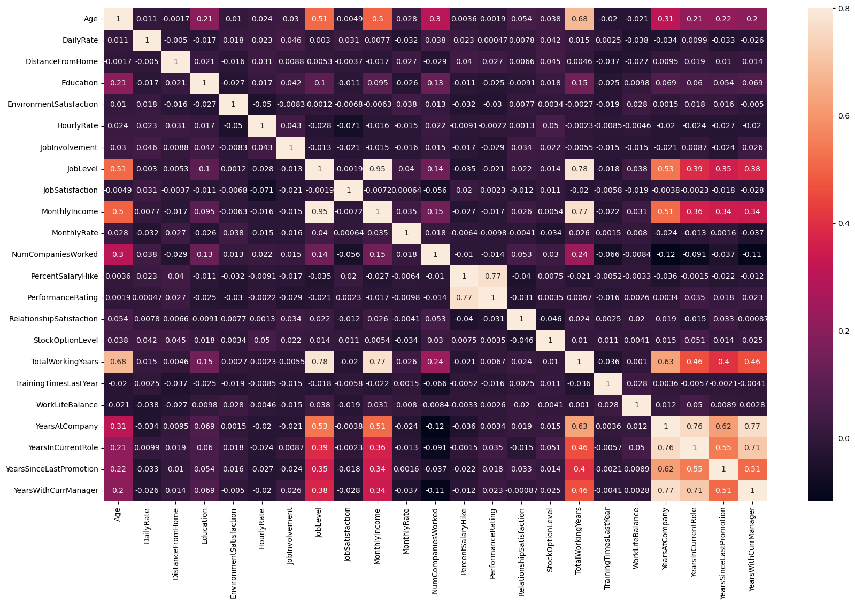
CORRELATION PLOT
____________________________________
Positive Correlation
-Total working years and Job Level
-Monthly Income and Job Level
-Monthly Income and Total working years
-Years at company and total working
years
-Years with current manager and
years at company.
Total Working years depend on the employee's age as well as years in the company.

Slide 15
DATA PREPARATION
__________________________________
Dropping Strongly Correlated features:
Dropped 3 strongly correlated variables ‘YearsInCurrentRole’, ‘TotalWorkingYears’ & ‘YearsWithCurrManager’, which makes the count of variables to 27.
Splitting:
Split the Data into 70% train and 30% test data.
Encoding:
Encoded Categorical Variables using OneHotEncoder which make the count of variables as 75.
Scaling:
Scaled the Numerical Variables using MinMaxScaler.

Slide 16
TREATING IMBALANCE DATA
____________________________________
Entire dataset
1470 observations
Train data (70%)
1029 observations
Test data (30%)
441 observations
Imbalanced data
Yes: 153
No: 876
Balanced data
Yes: 876
No: 876
SMOTE
Total 1752 observations
Model Evaluation
SMOTE Technique
SMOTE stands for Synthetic Minority Oversampling Technique. SMOTE is an improved method of dealing with imbalanced data in classification problems.

Slide 17
MODELLING & EVALUATION
____________________________________
Modelling
Random Forest
Logistic Regression
Evaluation
Confusion Matrix
AUC (Area under the ROC Curve)
Support Vector Machine
Accuracy
Recall
ROC curve (receiver operating characteristic curve)

Slide 18
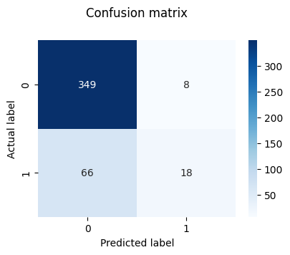
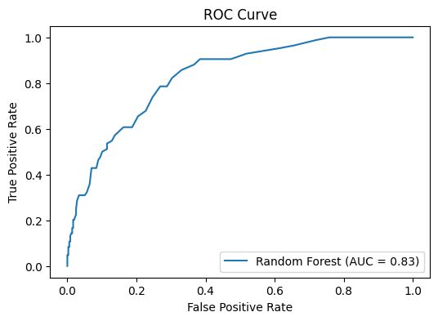
RANDOM FOREST CLASSIFIER
____________________________________
Random Forest Classifier is an ensemble learning algorithm that combines multiple decision trees to make more accurate predictions by reducing overfitting and increasing robustness.
 | TRAIN | TEST
ACCURACY | 0.10 | 0.83
RECALL | 0.10 | 0.21

Slide 19
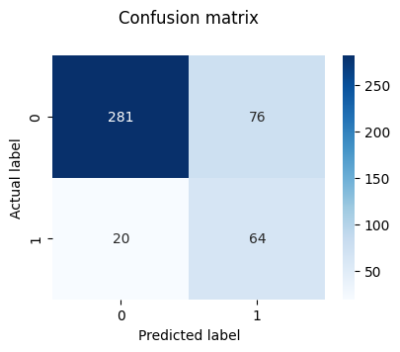
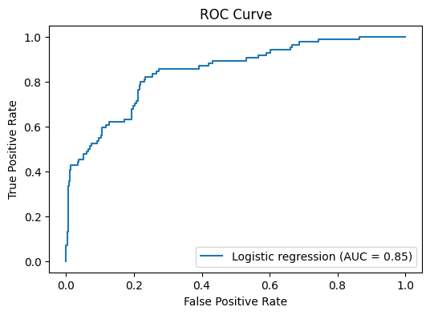
LOGISTIC REGRESSION
____________________________________
Logistic Regression is a popular statistical model used for predicting binary outcomes. It uses a logistic function to model the probability of a certain class or event.
 | TRAIN | TEST
ACCURACY | 0.83 | 0.78
RECALL | 0.85 | 0.76

Slide 20
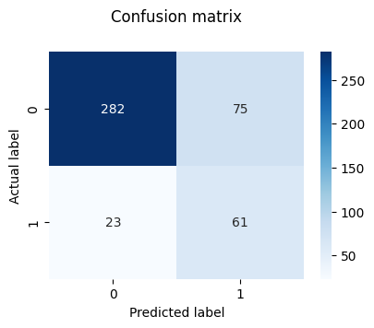
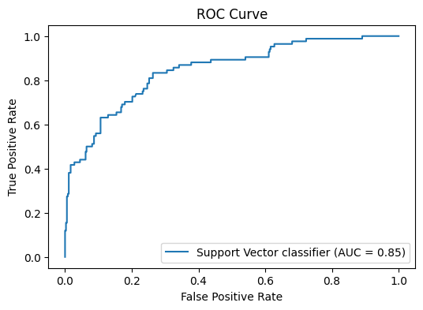
SUPPORT VECTOR CLASSIFIER
____________________________________
Support Vector Classifier (SVC) is a type binary classification algorithm that aims to find the best line or hyperplane that separates the data into different classes. It works by maximizing the margin, which is the distance between the decision boundary and the nearest data points of each class.
 | TRAIN | TEST
ACCURACY | 0.84 | 0.77
RECALL | 0.85 | 0.72

Slide 21
COMPARING THE MODELS
____________________________________
RANDOM FOREST CLASSIFIER
LOGISTIC REGRESSION
SUPPORT VECTOR CLASSIFIER
 | TRAIN | TEST
ACCURACY | 0.10 | 0.83
RECALL | 0.10 | 0.21
 | TRAIN | TEST
ACCURACY | 0.83 | 0.78
RECALL | 0.85 | 0.76
 | TRAIN | TEST
ACCURACY | 0.84 | 0.77
RECALL | 0.85 | 0.72
AUC SCORE: 0.83
AUC SCORE: 0.85
AUC SCORE: 0.85
Based on the above evaluation metrics, the Logistic Regression model appears to be the best performer as it has the highest Recall among the three models, and it also has a good balance between training and testing accuracy, and a better AUC score.

Slide 22
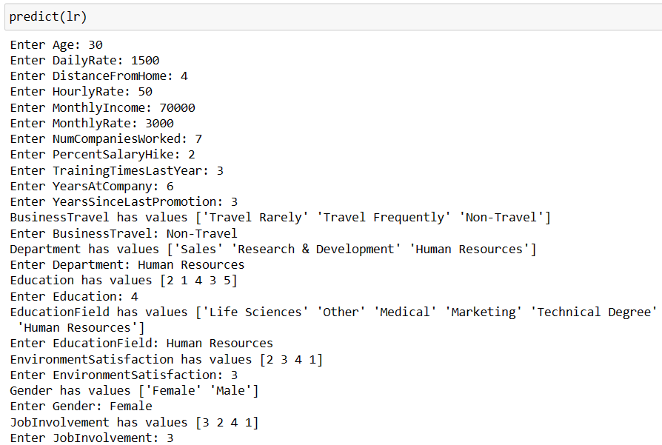
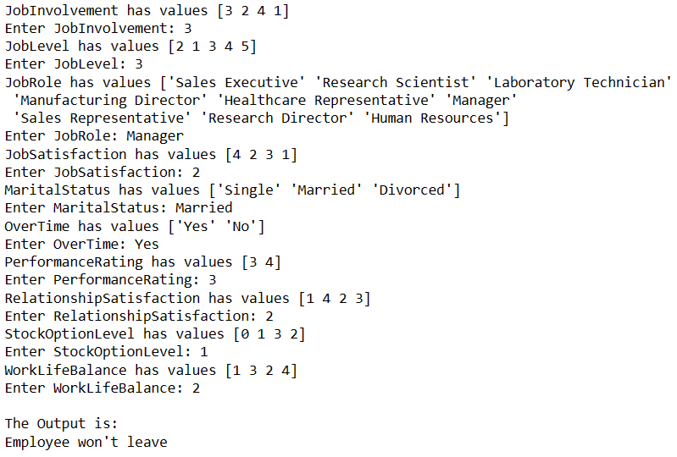
PREDICTION
____________________________________

Slide 23
REFERENCES
____________________________________
IBM HR Analytics Employee Attrition & Performance Dataset:
IBM HR Analytics Employee Attrition & Performance | Kaggle
RESEARCH PAPER:
Paper_49-Machine_Learning_for_Predicting_Employee_Attrition.pdf
Predicting_Employee_Attrition_with_Machine_Learning.pdf
SMOTE: https://towardsdatascience.com/smote-fdce2f605729
Logistic Regression: https://en.wikipedia.org/wiki/Logistic_regression
Random Forest: https://towardsdatascience.com/understanding-random-forest58381e0602d2
Support Vector Machine: https://www.javatpoint.com/machine-learning-support-vector-machine-algorithm

Slide 24
THANK YOU

